Slide 1
Website Optimization Project
Crafting & Compelling Website Analysis, Audit and Recommendations
MBT11 | Mesack Milton

Slide 2
Company Overview
Company Name: Apple Inc.
Description:
Apple Inc. is a global technology company known for its innovative products and services in electronics, software, and online services.
Founded in 1976, Apple is a leader in consumer technology, creating iconic devices like the iPhone, iPad, and MacBook, while also offering services such as the App Store, iCloud, and Apple Music

Slide 3
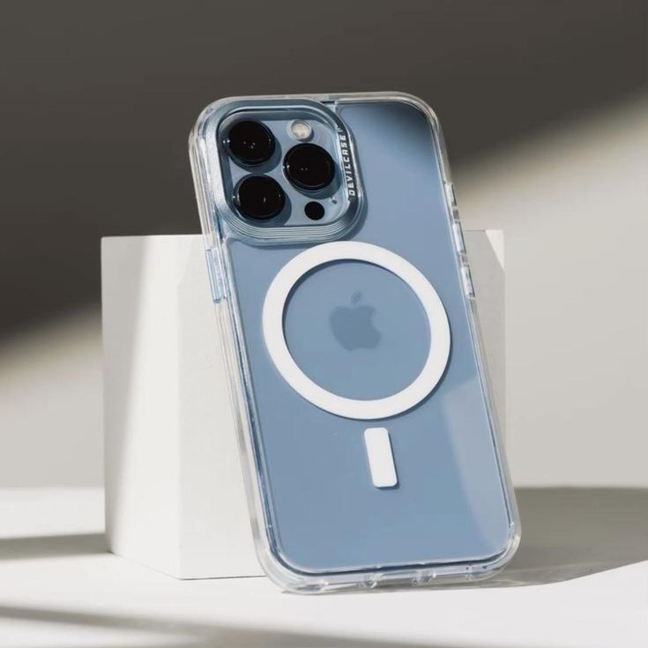

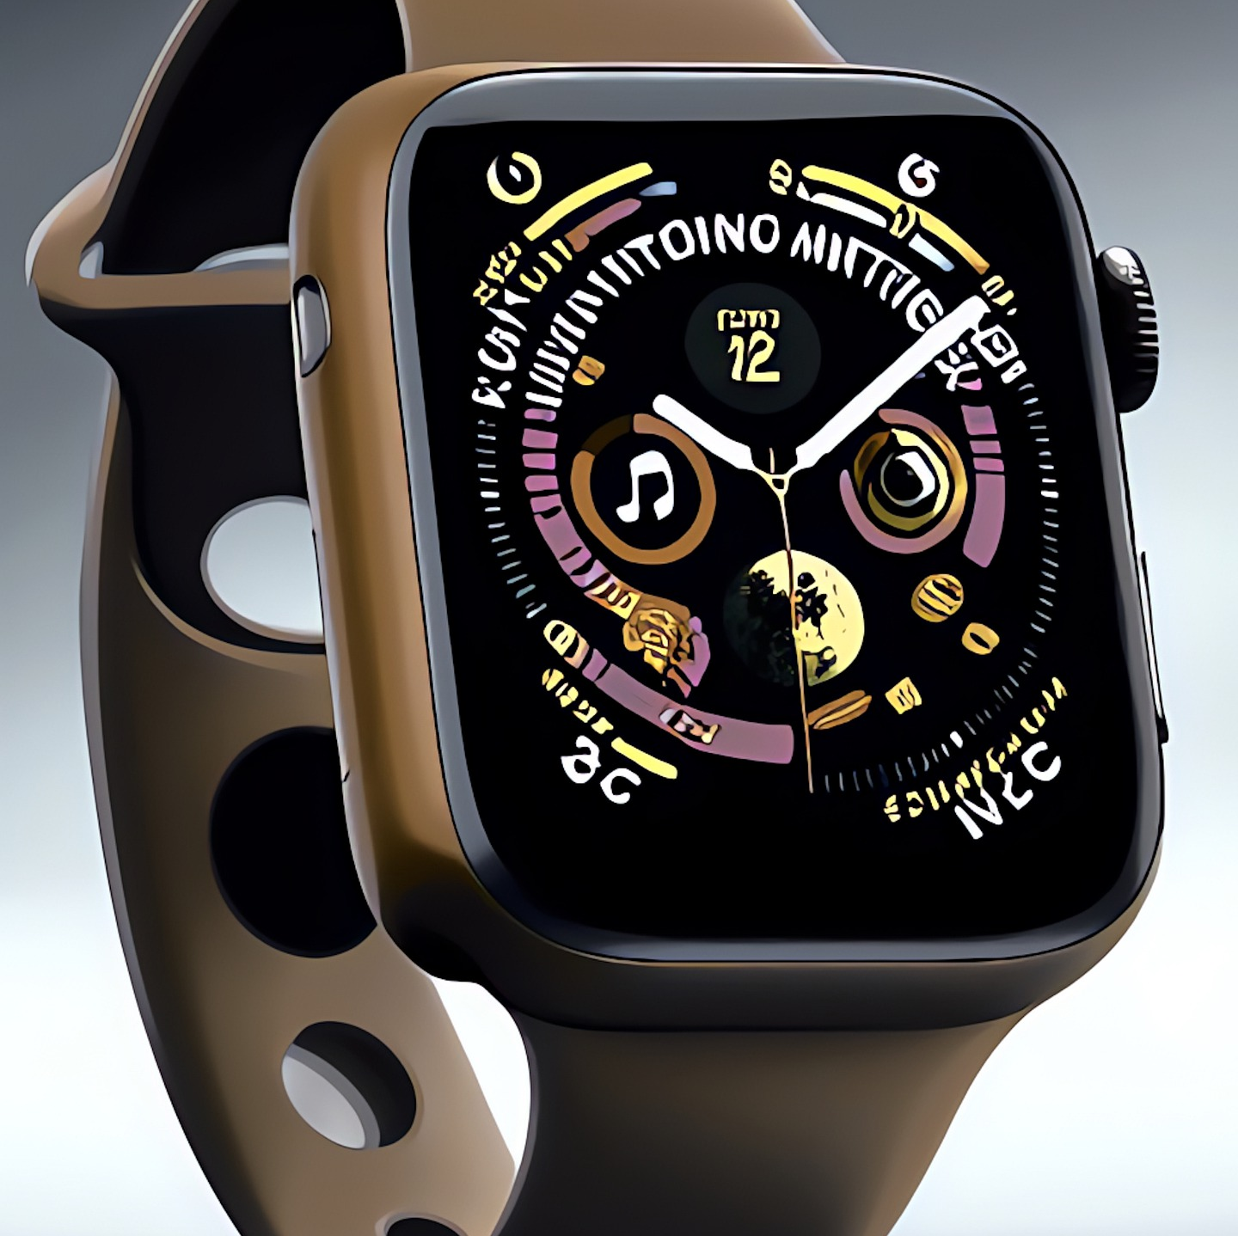

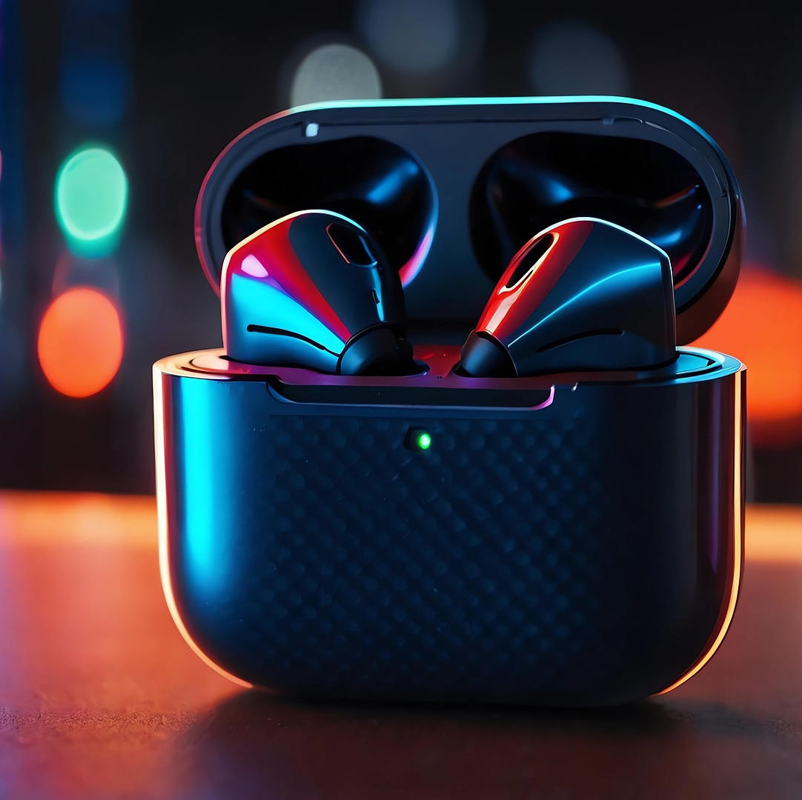
Product and Service Descriptions
1. Iphone
Apple’s flagship smartphone, featuring high-end technology, a seamless user experience, and an advanced camera system.
2. MacBook
A line of portable laptops optimized for productivity and creative work with macOS, popular among professionals and students.
3. Apple Watch
A wearable device that tracks fitness, monitors health metrics, and integrates with the iPhone for calls, notifications, and apps
4. Ipad
Versatile tablet with a high-resolution Retina display. Available in multiple models (iPad, iPad Air, iPad mini, iPad Pro) to suit various needs and tasks.
5.Airpods
High-quality wireless earbuds with active noise cancellation, Apple H1 chip, and long battery life.

Slide 4
Website Platform Identification
Apple Technology Stack
Web Server:
Confirmed: Nginx
Also detected: AkamaiGHost
Content Delivery Network (CDN):
Confirmed: Akamai
JavaScript Libraries:
Confirmed: jQuery
Also detected: Modernizr
Analytics and Tracking:
Confirmed: Google Analytics
Also detected: Adobe Analytics
Apple's website is primarily built using a combination of HTML, CSS, and JavaScript.
However, The exact platform or content management system (CMS) used for Apple's website has not been publicly disclosed.
Instead, Apple uses a custom-built platform this means: Apple has developed its own proprietary system for managing and serving its website content

Slide 5
Responsive Design Testing
Homepage: The homepage adapts well to different screen sizes, including mobile, tablet, and desktop. Images and text scale correctly without distortion. However, some navigation elements, like menus, could use improvement in spacing on smaller screens.
Mac Page: The Mac page performs similarly well, with text, buttons, and images resizing appropriately. The carousel and product images remain clear, even on smaller devices.
iPhone Page: This page is optimized for mobile devices and provides a seamless experience on all viewports. Elements like videos and animations load correctly, and scrolling remains smooth.
iPad Page: The iPad section performs well, though some larger images may load slower on mobile networks. The layout is responsive, with minimal issues.
Watch Page: The Apple Watch page offers smooth transitions and correct scaling of interactive elements, such as watch animations. On tablets, the experience is close to that of a desktop.

Slide 6
Minor Areas for Improvement
Loading Times: While the pages are fully optimized for mobile, some images, particularly on the homepage and product pages, could be further compressed to improve loading times on slower mobile networks.
Web Performance on Older Devices: Performance slightly lags on older devices compared to modern smartphones.

Slide 7
Website Mistakes Identification:
2. Slow Loading Times
Issue: Large high-resolution images and videos, especially on the product pages, lead to slower page load times. This can negatively impact user experience, particularly on mobile and slower connections.
Suggestion: Optimize media by compressing images into WebP format and using modern video compression techniques. Implement lazy loading so that images and videos load only when they enter the user’s view.
1. Disappearing Navigation on Scroll
Issue: The navigation bar disappears when scrolling down, making it harder for users to navigate to other parts of the website.
Suggestion: Implement a sticky navigation bar that remains visible as users scroll. This enhances the user experience by providing continuous access to the site’s main sections​

Slide 8
3. Excessive White Spaces
Issue: While white space can improve readability, certain areas on Apple’s pages have excessive empty space, which can make the layout feel disjointed and incomplete.
Suggestion: Optimize the use of white space by balancing content density and spacing.
4. Unstructured Navigation Menu
Issue: The navigation menu is comprehensive but not well-structured.
Suggestion: Restructure the navigation to include clearer categories and submenus. Use dropdowns with a well-organized hierarchy,
5. Lack of Clear Calls-to-Action (CTAs)
Issue: Some product pages have CTAs ("Buy Now," "Learn More") that blend in with the page, making them less visible to users.
Suggestion: Use contrasting colors and more prominent placement for CTAs. Adding micro-interactions, such as hover effects, can also draw attention to these buttons and encourage clicks​

Slide 9
Best Practices List
Visual Design
Use a consistent color scheme
Choose a primary color and 1-2 complementary colors
Use tools like Adobe Color or Coolors for color harmony
Implement a clear visual hierarchy
Use size, color, and spacing to guide users' attention
Ensure the most important elements stand out
Choose readable fonts
Use sans-serif fonts for better on-screen readability
Limit the number of font families to 2-3 maximum
4. Maintain adequate contrast
Ensure text is easily readable against its background
Use tools like WebAIM's Contrast Checker to verify
5. Use high-quality, relevant images
Avoid generic stock photos
Optimize images for web to ensure fast loading

Slide 10
User Experience (UX)
Design with mobile-first approach
Ensure the site is fully responsive
Test on various devices and screen sizes
Implement intuitive navigation
Use clear, descriptive labels
Limit main navigation items to 7 or fewer
Ensure fast loading times
Optimize images and other media
Minimize HTTP requests
Use browser caching
4. Make important information easily accessible
Follow the "three-click rule" for important content
Use clear calls-to-action (CTAs)
5. Implement search functionality
Make the search bar easily visible
Provide relevant search suggestions

Slide 11
Landing Page Design
The iPhone 16 Pro landing page has been crafted with a focus on user engagement and product promotion, effectively showcasing the device’s premium features and driving conversions. Key elements include:
Visually Striking Hero Section
Feature-Rich Overview
Lead Generation Focus
Seamless User Experience
Conversion-Oriented Structure
Modern, Clean Design
Landing Page : https://milton-mesack.my.canva.site/iphone-16-pro-landing-page

Slide 12
Thank You

